Slide 1
Designing and Evaluating Different Methodologies to Asses Critical Activities Within an Organization using Process Mining
Abou Keita

Slide 2
Table of Content
Purpose
Introduction
Introduction and Ontology of an event log
Terminologies
Techniques Implementations after
Critical Path Method
Genetic Algorithm
EasyGA
EasyGA w/ process discovery modelling
Dataset
Results and Evaluation
Comparing different techniques implementations

Slide 3
Purpose
Identify key task/activity in a business process
Identify possible point of interest that can be improved and their relation to each other
Help business get more OBJECTIVE insight about their internal/external processes
To reduce unnecessary task/activity in a current process
Identify bottleneck in day-to-day process
As organizations scale, it is harder to manage task/activities efficiently and objectively as they inherently become more complex and intertwined
This research is aimed to provide multiple avenue to reason and improve the complex nature of business process

Slide 4
Questions to answer
Can the PM4PY be utilized in a commercial setting effectively?
If so, what are the benefit compared to current implementations
Limits of PM4PY
Which techniques and implementations tested is the most suitable in a commercial enterprise?
Which is worst?

Slide 5
Hypothesis
The Critical Path Method would be suitable to commercial enterprise and perform the best

Slide 6
Process Mining
process mining (PM) discipline emerged in the late 1990s at the Eindhoven University of Technology with the pioneering work of prof.dr.ir. Wil van der Aalst.
defined as an analytical discipline for discovering, monitoring, and improving business processes as they actually are- not as you think they might be.
works by extracting knowledge from event logs readily available in today’s information systems, in order to visualize business processes — and their every variation — as they run.
Adds the process perspective to machine learning and data mining.
Seeks the confrontation between event data (i.e., observed behavior) and process models (hand-made or discovered automatically). Event data are
related to explicit process models, e.g., Petri nets or BPMN models. For example, process models are discovered from event data
Notes:
Field is relatively new and growing rapidly

Slide 7
Why PM?
There are many benefits to process mining:
Objective, fact-based insights
It offers objective, fact-based insights, derived from actual data, to help you audit, analyze, and improve your existing business processes.
Faster, cheaper and more accurate
It is faster, cheaper and more accurate than the lengthy and often subjective process mapping workshops.
No rip-and-replace needed
Process mining works on top of your existing systems, helping you to leverage your existing technology investments. There is no rip-and-replace involved.

Slide 8
PM Steps
Extracting data:
Process discovery
Conformance checking
Performance analysis

Slide 9
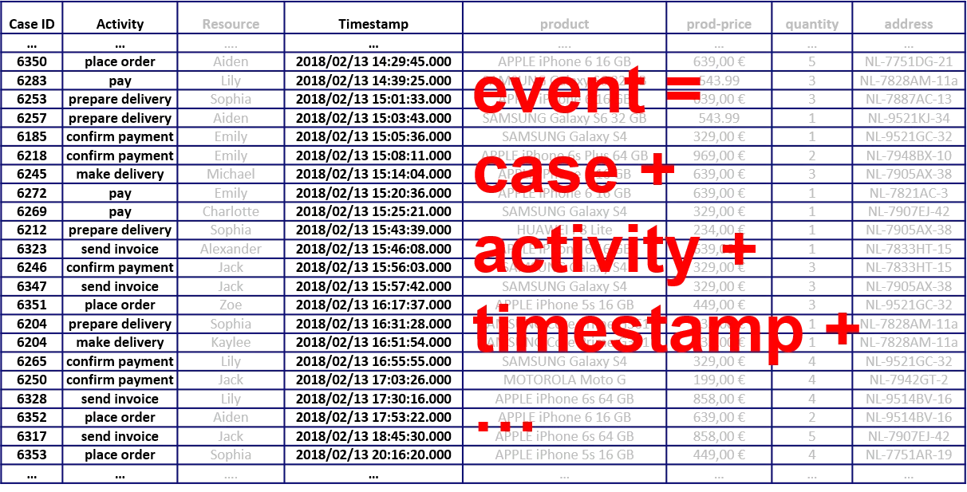
Extract data
Collecting event data through her e-commerce website. Event data consists of information about case ID, activity, and timestamp, for example: on 13/2/2018 at 14:29:45, Aiden placed an order with ID 6350.

Slide 10
Process discovery
With the collected data, the user applies different process discovery algorithms and finds out the actual process happening.

Slide 11
Conformance checking
Conformance checking is usually used to evaluate newly generated model or ideal model compared to what is actually happening. For this project, Conformance checking algorithms are used to evaluate the generated model by the different methods by comparing the original model to the generated one.
Having the process model, Users can replay the event data on this model to figure out if there are any deviations between the real-life process (happening every day) and the ideal process (from the model).

Slide 12
Performance analysis
For this project, Performance analysis is utilized to described the different behavior of the generated models compared to the original datasets
Utilized to discover the bottlenecks occurring in her the event log.

Slide 13
Event Logs

Slide 14
Event Log
Process mining assumes the existence of an event log where each event refers to a case, an activity, and a point in time. An event log can be seen as a collection of cases and a case can be seen as a trace/sequence of events.
Event data may come from a wide variety of sources:
a database system (e.g., patient data in a hospital),
a comma-separated values (CSV) file or spreadsheet,
a transaction log (e.g., a trading system),
a business suite/ERP system (SAP, Oracle, etc.),
a message log (e.g., from IBM middleware),
an open API providing data from websites or social media

Slide 15
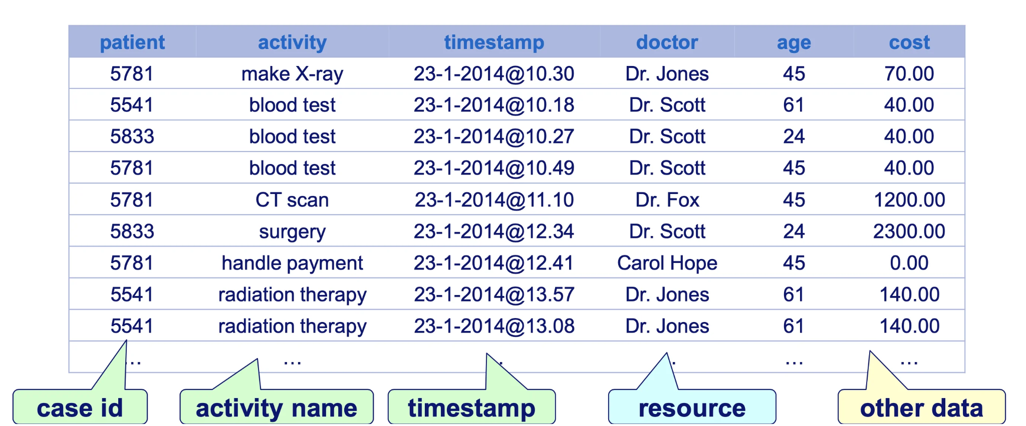
Ontology of an event log

Slide 16

Current Process Mining Application State-of-the-art
Notes:
Some commercial, some open-source

Slide 17
PM4PY: Process Mining 4 Python
An Python open-source library process mining tool founded by Sebastiaan van Zelst,
Notes:
Used to interact directly with the event log and perform all the necessary model generation

Slide 18
Methods
Original Dataset model
Crtiical Path Method
EasyGA
EasyGa w/ BPMN modelling

Slide 19
Critical Path Method
a technique where you identify tasks that are necessary for project completion and determine scheduling flexibilities. A critical path in project management is the longest sequence of activities that must be finished on time in order for the entire project to be complete. Any delays in critical tasks will delay the rest of the project.
CPM revolves around discovering the most important tasks in the project timeline, identifying task dependencies, and calculating task durations.
CPM was developed in the late 1950s as a method to resolve the issue of increased costs due to inefficient scheduling. Since then, CPM has become popular for planning projects and prioritizing tasks. It helps you break down complex projects into individual tasks and gain a better understanding of the project’s flexibility.

Slide 20
Critical Path Method Steps
List activities
Identify dependencies
Create a network diagram
Estimate task duration
Calculate the critical path
Calculate the float
Float, or slack, refers to the amount of flexibility of a given task. It indicates how much the task can be delayed without impacting subsequent tasks or the project end date.
Critical tasks have zero float, which means their dates are set. T
asks with positive float numbers belong in the non-critical path, meaning they may be delayed without affecting the project completion date.
If you’re short on time or resources, non-critical tasks may be skipped.
Notes:
Manually calculated the cpm, there can be human errors with complex and large activities number and relationships
If we can Algothirmaclly solve for the cpm of any given datasets, thall be great, but it is uccrently impossible in PM4PY. Also, some dependency needs to make sense as sometimes, some activities might be connected but those might be outliers and do not define the entire process model

Slide 21
EasyGA
EasyGA - Genetic Algorithms made Easy
EasyGA is a python package designed to provide an easy-to-use Genetic Algorithm. The package is designed to work right out of the box, while also allowing the user to customize features as they see fit.
Notes:
https://github.com/danielwilczak101/EasyGA

Slide 22
Genetic Algorithms
A method for solving both constrained and unconstrained optimization problems that is based on natural selection, the process that drives biological evolution.
The genetic algorithm repeatedly modifies a population of individual solutions.
At each step, the genetic algorithm selects individuals from the current population to be parents and uses them to produce the children for the next generation.
Over successive generations, the population "evolves" toward an optimal solution.
You can apply the genetic algorithm to solve a variety of optimization problems that are not well suited for standard optimization algorithms, including problems in which the objective function is discontinuous, nondifferentiable, stochastic, or highly nonlinear. The genetic algorithm can address problems of mixed integer programming, where some components are restricted to be integer-valued.
Notes:
https://towardsdatascience.com/introduction-to-genetic-algorithms-including-example-code-e396e98d8bf3
https://www.geeksforgeeks.org/genetic-algorithms/
https://www.mathworks.com/help/gads/what-is-the-genetic-algorithm.html
https://www.mathworks.com/help/gads/how-the-genetic-algorithm-works.html

Slide 23
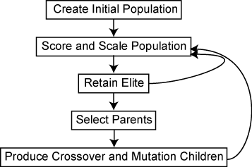
The genetic algorithm uses three main types of rules at each step to create the next generation from the current population:
Selection rules select the individuals, called parents, that contribute to the population at the next generation. The selection is generally stochastic, and can depend on the individuals' scores.
Crossover rules combine two parents to form children for the next generation.
Mutation rules apply random changes to individual parents to form children.
For this research, I am trying to minimize the number of activities to be completed within a limited time frame

Slide 24
Steps for the research

Slide 25
Methodologies
Generate Process Disocovery , performance analysis, and statistics the original dataset
Perform each methodologies on the dataset to gather the result of what activities would be considered important on the three methods
Generate Process Discovery, performance analysis, and statistics of each different methods results
Evaluate how each outputted results deviated from the original dataset

Slide 26
Datasets
3 Datasets

Slide 27
Review Example Large: Synthetic event logs commonly used as example for pm
HelpDesk: Event log of a help desk process
BPI 2012 Challenge: Event log of a loan application process
Focus on Review Example Large for this presentation
Notes:
https://data.4tu.nl/articles/dataset/Synthetic_event_logs_-_review_example_large_xes_gz/12716609
https://github.com/AdaptiveBProcess/GenerativeLSTM/blob/master/input_files/event_logs.zip
https://data.4tu.nl/articles/dataset/BPI_Challenge_2012/12689204

Slide 28
Results
Review Example Large Dataset

Slide 29
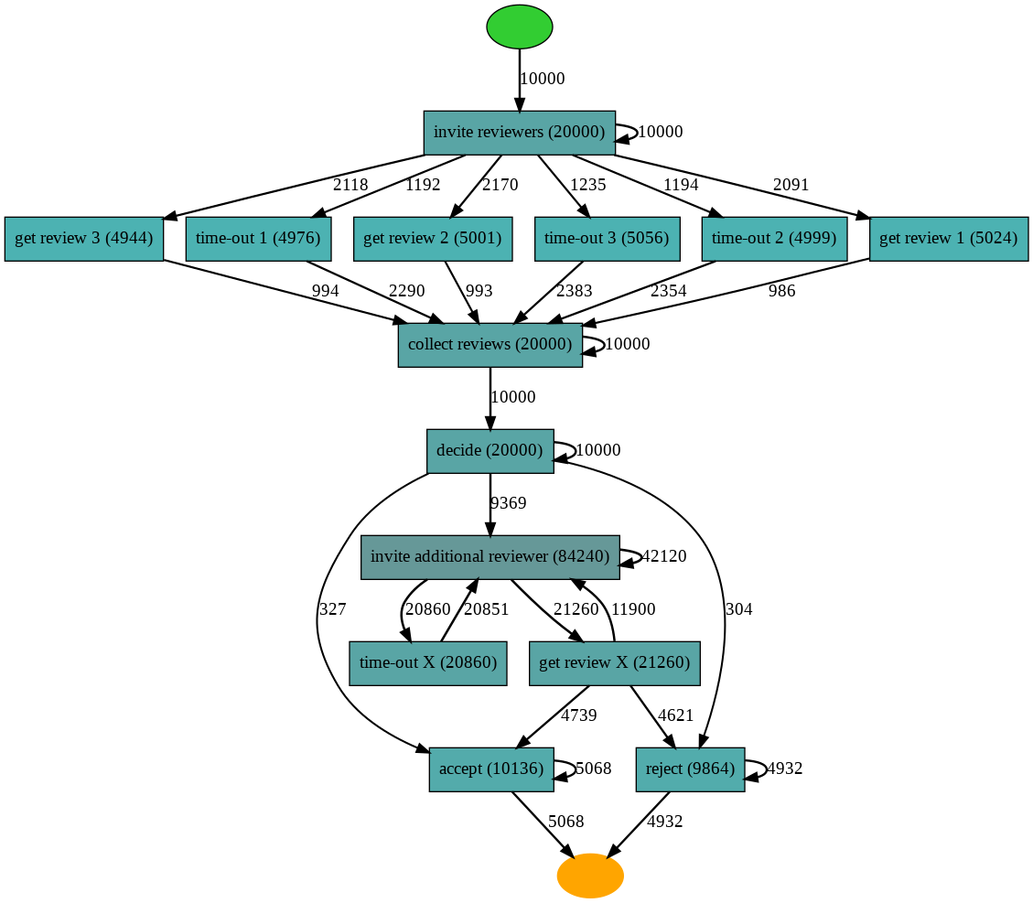
Original Heuristics Model
Number of event: 236360
Number of case: 10,000
Number of resource: 14

Slide 30
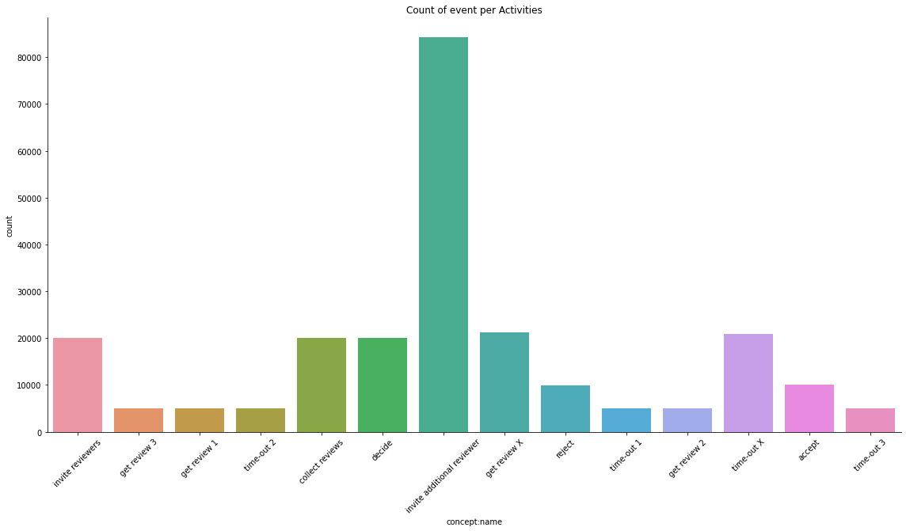
Original EDA

Slide 31
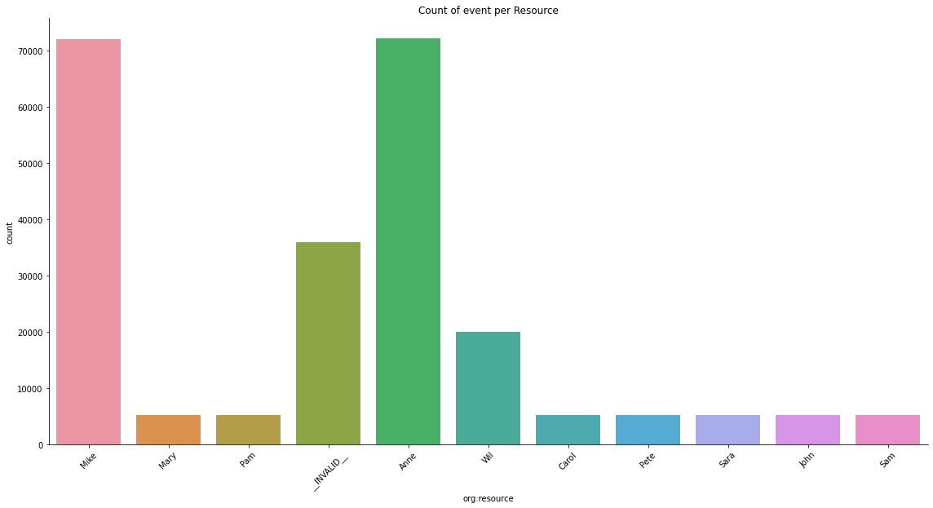
Original EDA 2

Slide 32
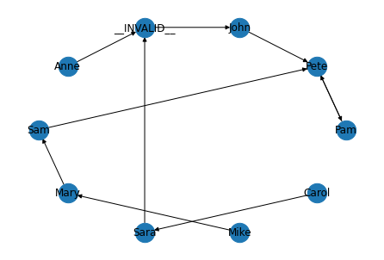
Original Subcontracting Social Network Analysis
Median case duration in second: 2654294400.0 second
Median case duration in days: 30721.0 days
Notes:
The subcontracting metric calculates how many times the work of an individual is interleaved by the work of some other individual, only to eventually “return” to the original individual.
Result: Pete has work that is interleaved by John, Mary, and Pam that eventually comes back to him. On the other hand, the three people who do not interleaved other people's work are :
Mike, Anne, and Carol

Slide 33
Critical Path Method

Slide 34
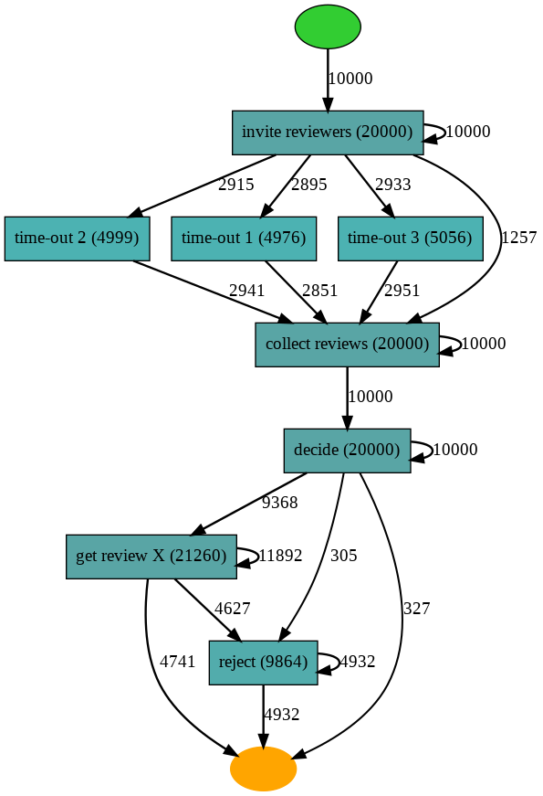
CPM Heuristics Model
Number of event: 106155
Number of unique cases: 10000
The resources or people involved are: ['Mike' '__INVALID__' 'Anne' 'Wil' 'Mary' 'Pete' 'Sara' 'Pam' 'Carol'
'John' 'Sam']
The number of resources are: 11

Slide 35
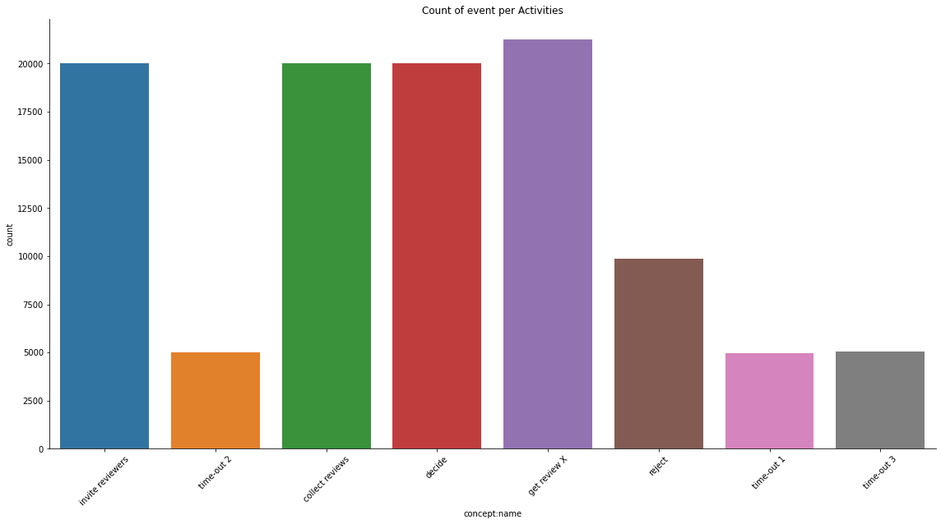
CPM EDA
Notes:
More evenly distributed count of event per activity

Slide 36
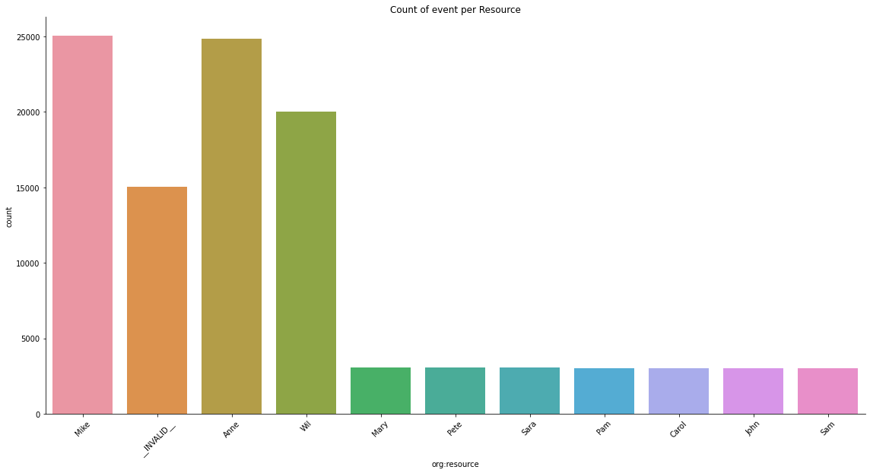
CPM EDA 2
Notes:
very few people are gonna be heavily involved in this case, more participate from Anne.

Slide 37
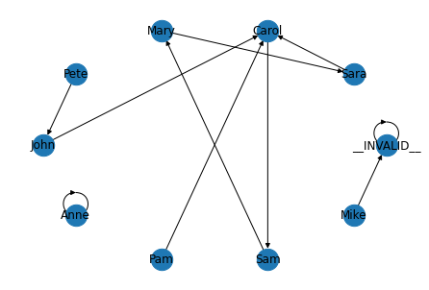
CPM Similar Activity Social Network Analysis
Median case duration in second: 2654035200.0 second
Median case duration in days: 30718.0 days

Slide 38
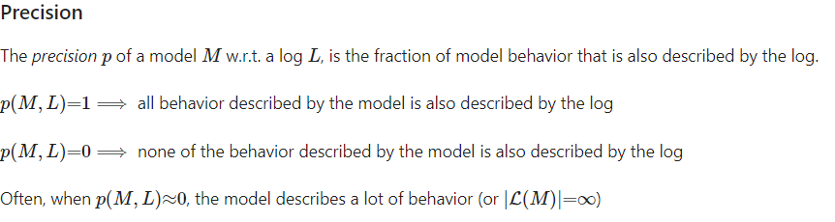
CPM Evaluation (generated model compared to original)
token_based_replay compared to original log: 29.17%
alignments compared to original log: 46.28%
Reduced median case duration by 3 days

Slide 39
Custom Genetic Algorithm

Slide 40
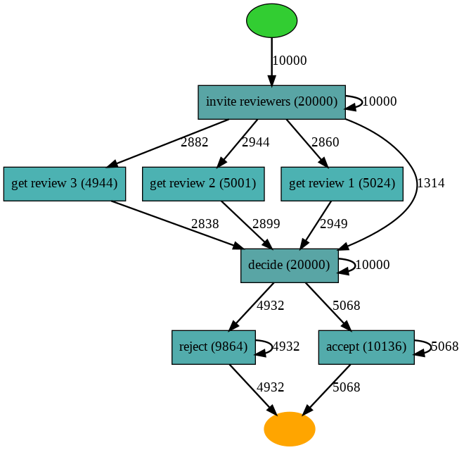
Custom GA Heuristic Model
number of event: 74969
Number of unique cases: 10000
The resources or people invovled are: ['Mike' 'Mary' 'Pam' 'Wil' 'Anne' 'Carol' 'Pete' 'John' 'Sam' 'Sara']
The number of resources are: 10
Notes:
A lot less people will need to be involved
Significant event number drop

Slide 41
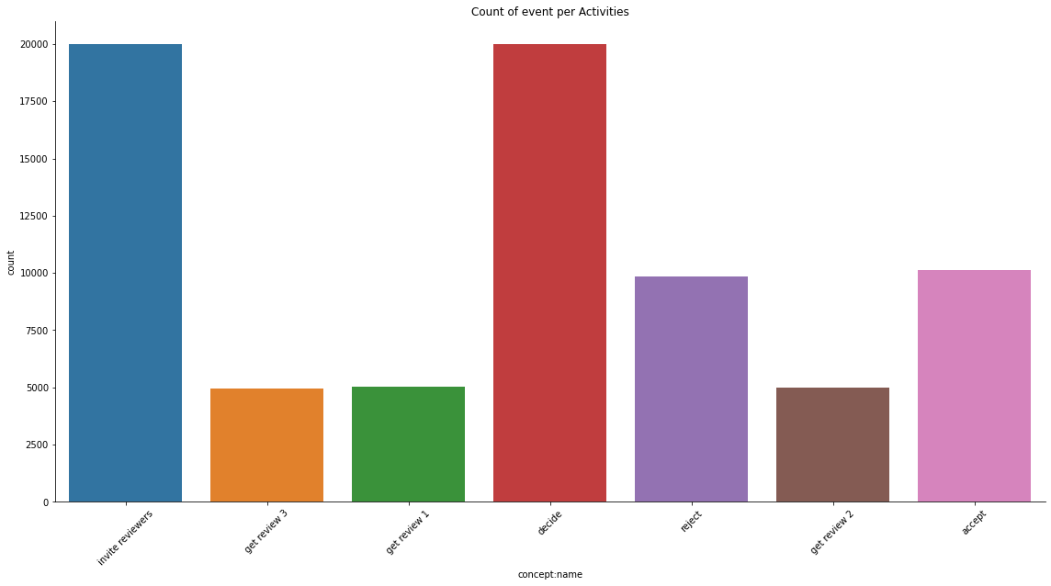
Custom GA EDA

Slide 42
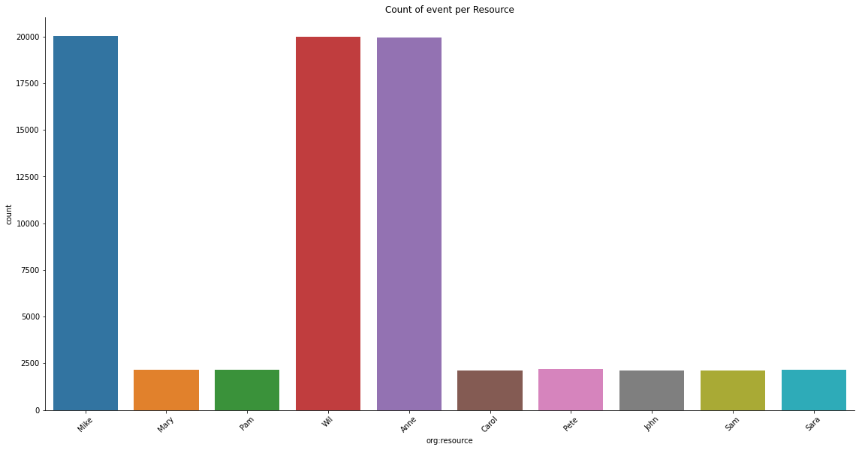
Custom GA EDA 2

Slide 43
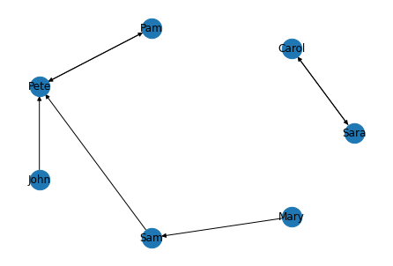
Custom GA Subcontracting
Median case duration in second: 2654294400.0 second
Median case duration in days: 30721.0 days
Notes:
No increase in median case duration

Slide 44
Custom GA Evaluation
token_based_replay compared to original log: 20.86%
alignments compared to original log: 48.23%

Slide 45
EasyGA

Slide 46
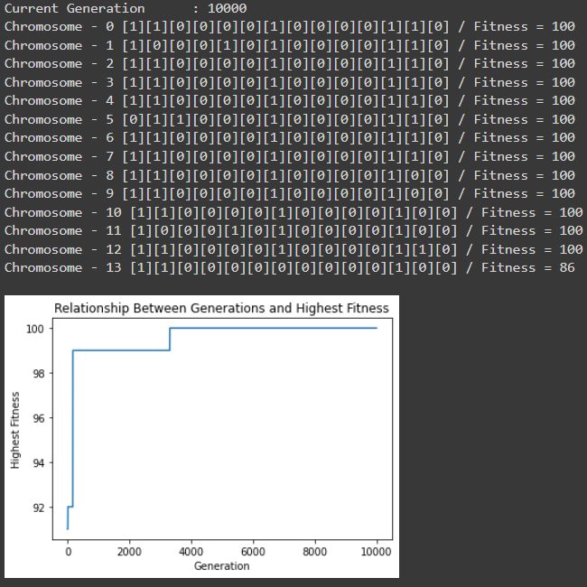

Slide 47
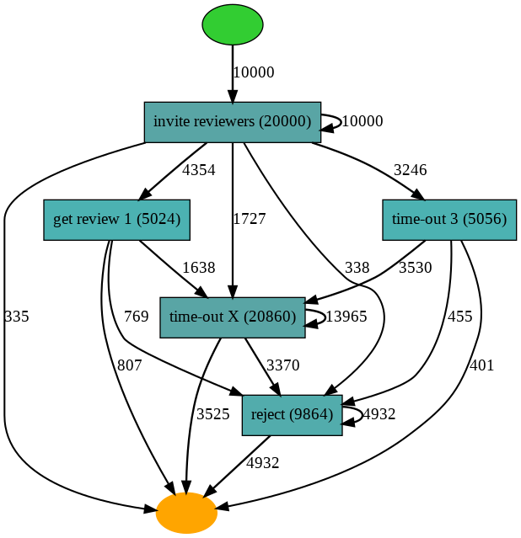
EasyGA Heuristic Model
number of event: 60804
Number of unique cases: 10000
The resources or people invovled are: ['Mike' 'Pam' 'Anne' '__INVALID__' 'John' 'Carol' 'Sara' 'Pete' 'Mary'
'Sam']
The number of resources are: 10
Notes:
Fewest amount of resource involved
fevest event generated
Breaks patterns in the overall process

Slide 48
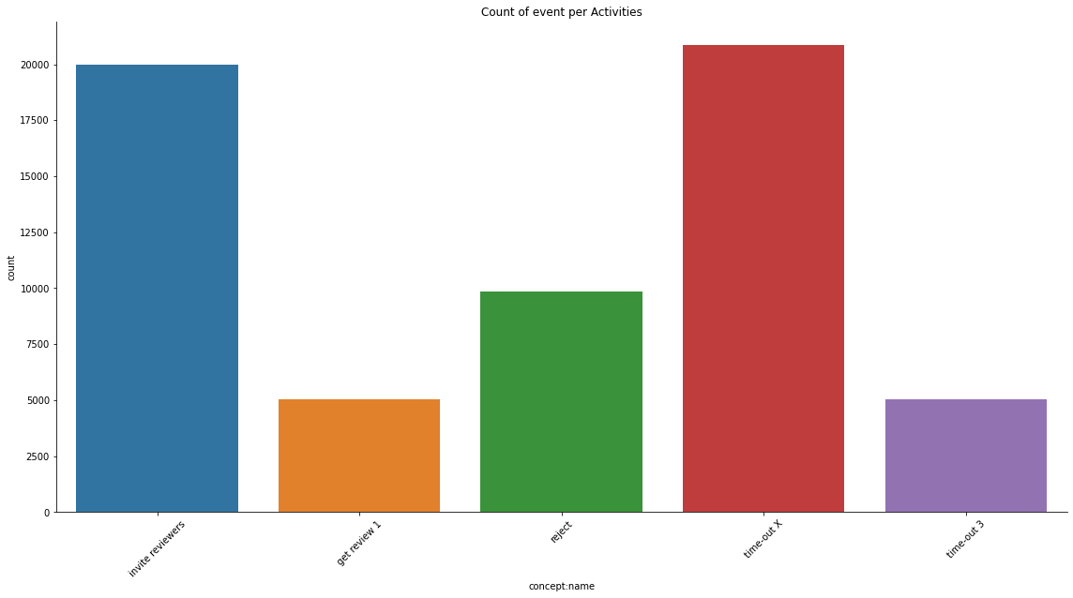
EasyGA EDA

Slide 49
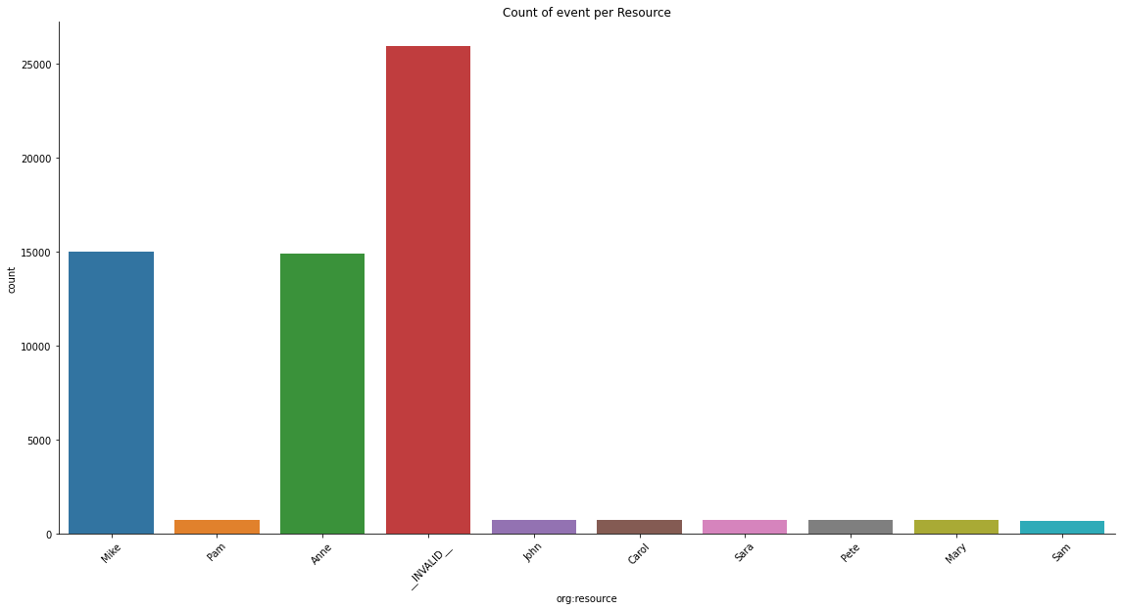
EasyGA EDA 2
Notes:
invalid means a lot of those events are terminated

Slide 50
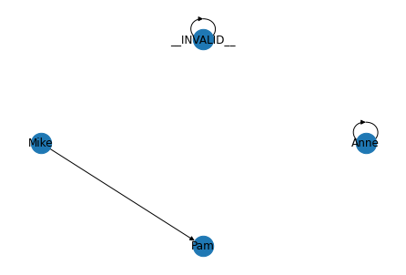
EasyGA Subcontracting
Median case duration in second: 2654294400.0 second
Median case duration in days: 30721.0 days - no decrease

Slide 51
EasyGA Evaluation
token_based_replay compared to original log: 18.55%
alignments compared to original log: 35.64%

Slide 52
EasyGA w/ BPMN Model

Slide 53
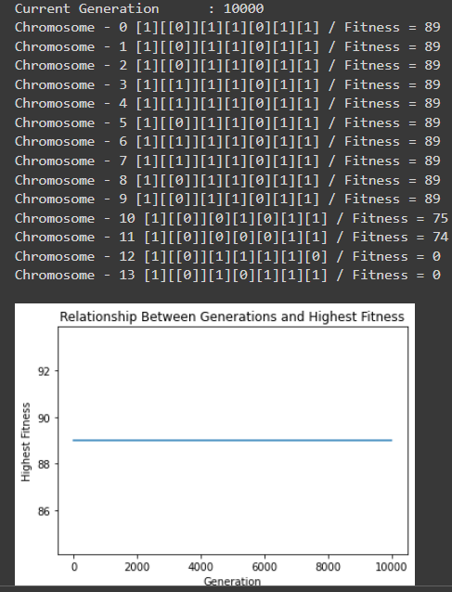

Slide 54
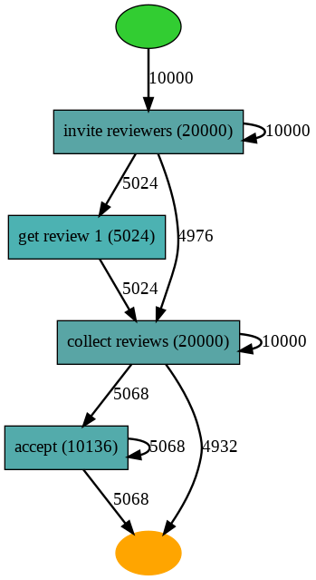
EasyGA w/ BPMN Heuristic Model

Slide 55
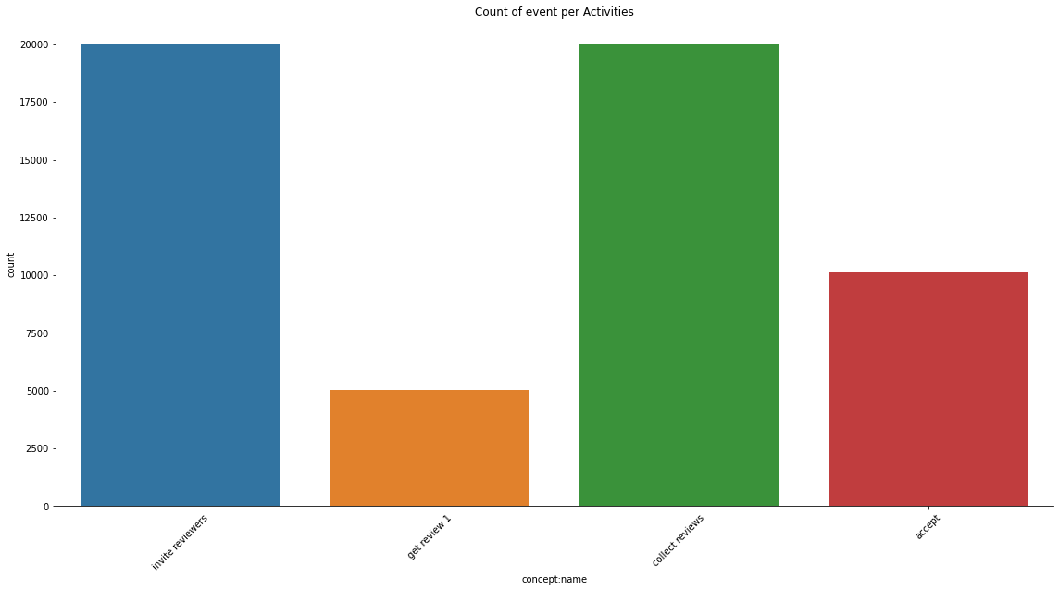
EasyGA w/ BPMN EDA
number of event: 55160
Number of unique cases: 10000
The resources or people invovled are: ['Mike' 'Pam' 'Anne' 'John' 'Carol' 'Sara' 'Pete' 'Mary' 'Sam']
The number of resources are: 9
Notes:
No invalid
fewest of events and resources

Slide 56
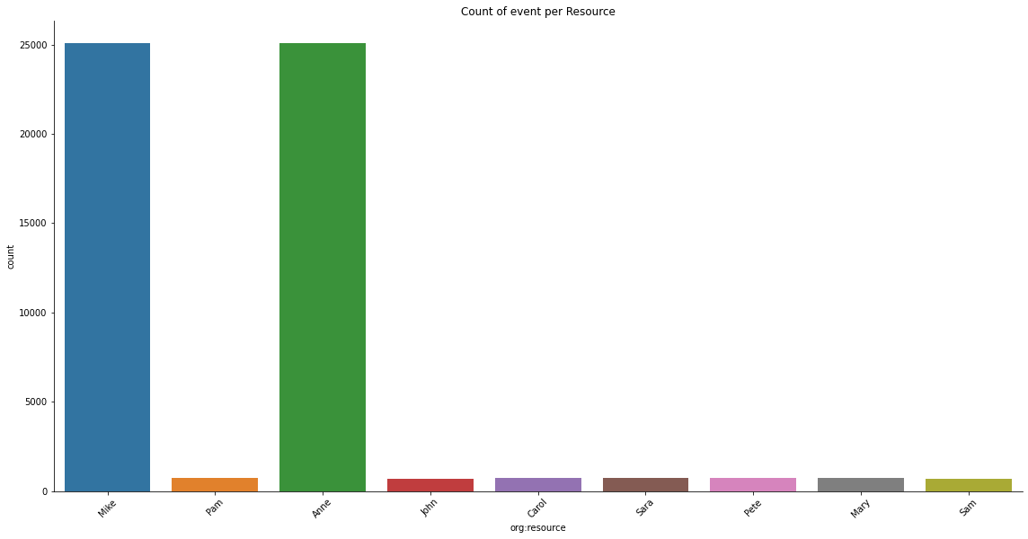
EasyGA w/ BPMN EDA 2

Slide 57

EasyGA w/ BPMN Subcontracting
Median case duration in second: 4233600.0 second
Median case duration in days: 49.0 days
Notes:
minimize the most

Slide 58
EasyGA w/ BPMN Evaluation
token_based_replay compared to original log: 17.24%
alignments compared to original log: 41.61%
Notes:
Lowest, make sense since it is more optimized
Biased?

Slide 59
Conclusion

Slide 60
My hypothesis was disproved based on the result. CPM does not minimize the fewest activity. However, it is the only one that reduces the median days
EasyGA and EasyModeling performed the best with signiticaly reduce event number and resources involved.
The more the Genetic Algorithm is modelled like the process, the more precise it gets. However, it does lose fitness and alignment so some important activities will be lost.

Slide 61
Answering research question

Slide 62
Can the PM4PY be utilized in a commercial setting effectively?
No, as of making this research, PM4PY is too limited in its capabilities to work on large scale projects/organizations.
The modelling of the process are not as accurate as enterprise level
The constant update is nice as it shows that the founder still cares about the project. However, the changes made can break certain function as their function location, and output’s type changed in the middle of the project.
However, it is still usable for smaller scale and less complex event data.

Slide 63
Which techniques and implementations tested is the most suitable in a commercial enterprise?
CPM: In term of identifying dependencies between activities, CPM is not commercial ready until there are more suitable tools to automate the calculation of each steps. The manual calculation can lead to human error or misinterpretation of the model relationships among activities
Genetic Algorithm: This project showed that there is possibility to implement genetic algorithm into process mining. However, it proves that the challenges will come in tuning the optimization aspect and fitness of the algorithm.
CPM performed the worst in most area of improvement and has only a 10% token-replay and alignment to the original dataset.

Slide 64
Future Work
Notes:
Advantages and disadvantages of each implementation

Slide 65
Explore the area of optimization with genetic algortihicm
I had a generation limit ofm 10,00 which is overkill, so there needs to be research done in finding a lower or more optimal limit.
Explore different fitness limit and fitness function such as mimicking certain available models
Explore the maximization or minimization other parameter such as event time duration, resource involved
Explore the nuances and limitations of modelling processes as they can be hard to model with very complex with
Explore an algorithm CPM approach instead of a manual one

Slide 66
THE END
QUESTIONS?

